Slide 1
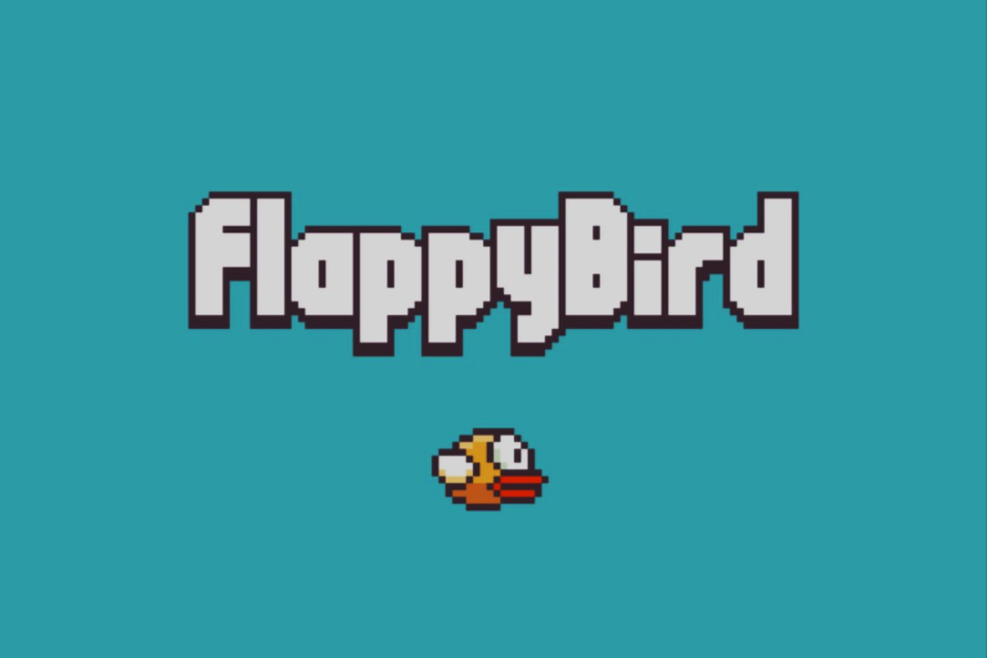
Flappy Bird Game - Code Overview
An Exploration of Flappy Bird Game Code

Slide 2
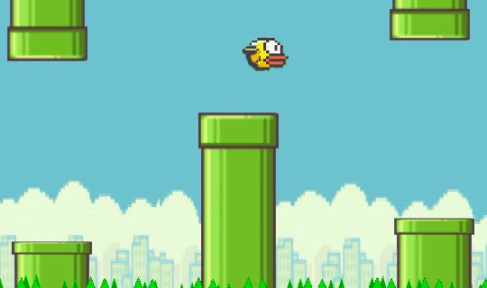
How to Play
Press Space bar to start game.
Up Arrow to make the bird fly.
Make sure you avoid pipes
Crossing Each pipes will be a score point

Slide 3
Introduction to Flappy Bird Game
Developed by Dong Nguyen, Flappy Bird was released on May 24, 2013, and gained immense popularity.
Players control a bird by tapping the screen to navigate it through pipes, presenting easy-to-understand mechanics with a high level of difficulty.
Flappy bird is a mobile platform based application which is highly addictive in nature
Its easy controls and addictive gameplay made it as the award winning game of the year 2014.

Slide 4
Gameplay Overview
How to Play Flappy Bird:
Simple controls : Press Spacebar or tap on screen to start the game
Pressing spacebar or upper arrow key will help the flappy bird to fly through pipes and will able to score.
Reach as far as possible to score high and be the top scorer among your friends and co.

Slide 5
Code Overview
High-Level Code Structure : The code structure of Flappy Bird is organized to efficiently handle the game's mechanics.
The main components include modules for graphics rendering, user input, game logic, and collision detection.
The code is modular, with distinct functions for tasks like updating the game state, handling user input, and rendering graphics.
Clear indentation and consistent naming conventions contribute to readability.
The game loop, responsible for continuously updating and rendering the game, ensures smooth gameplay. Additionally, error handling and documentation are crucial aspects, given the simplicity yet challenging nature of the game.
The code structure reflects a balance between simplicity for rapid gameplay and complexity for managing the game's dynamics.

Slide 6
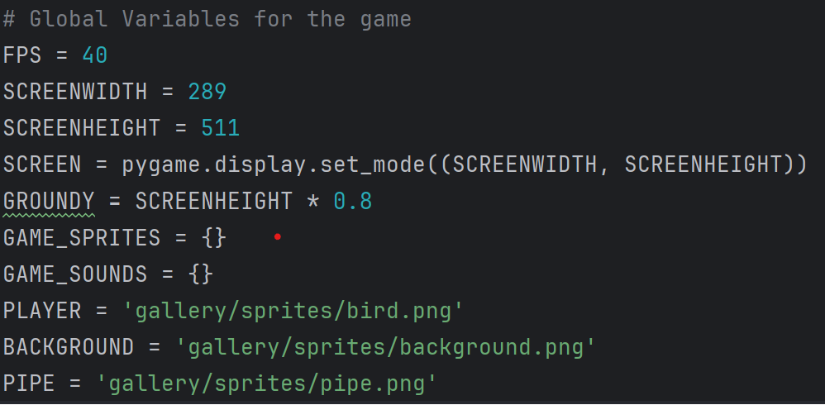
"Variables and Globals"
This slide focuses on the foundational elements that drive the Flappy Bird gamw.
Variables and global constants such as
SCREENWIDTH,
SCREENHEIGHT,
GROUNDY, and FPS
play crucial roles in determining the game's dimensions,
ground level, and frames per second.
Understanding these parameters is essential for grasping
how the game mechanics and visual elements are defined and controlled within the code.

Slide 7
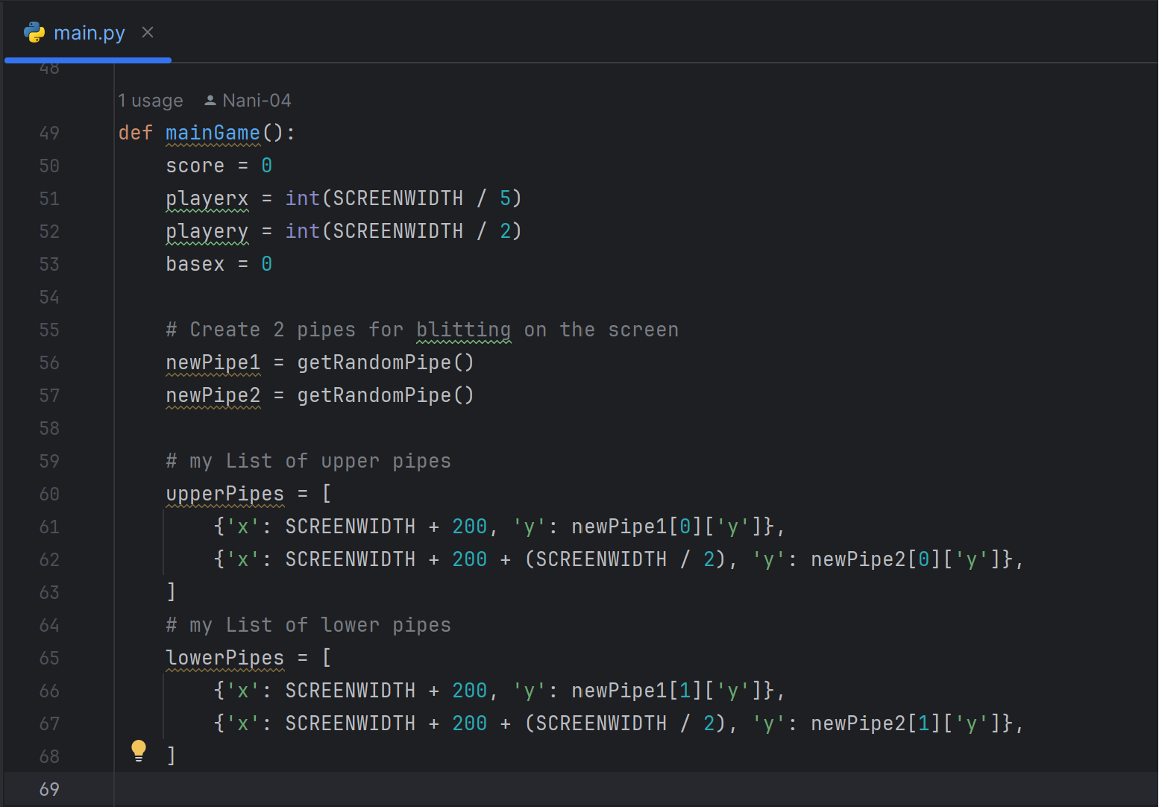
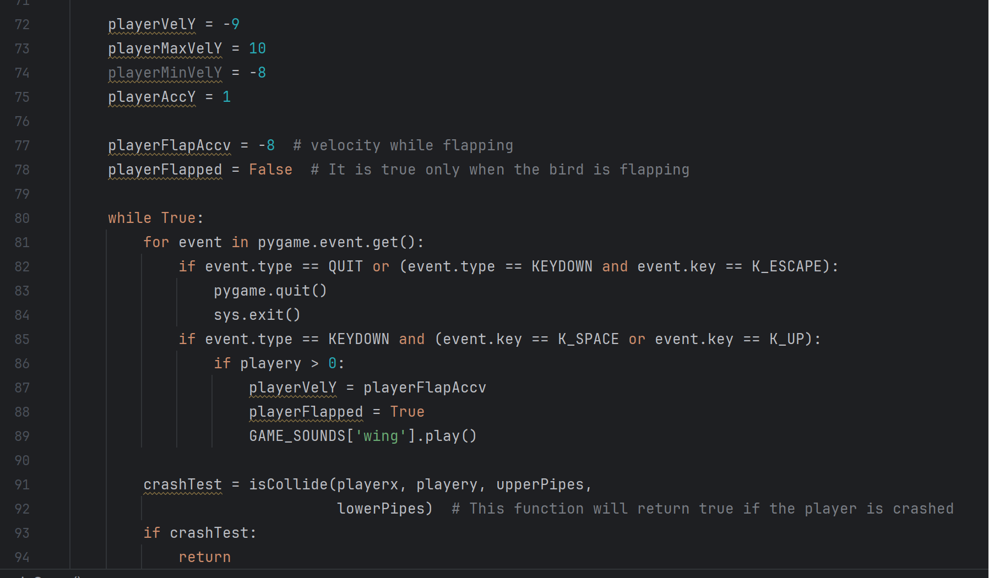
mainGame():

Slide 8
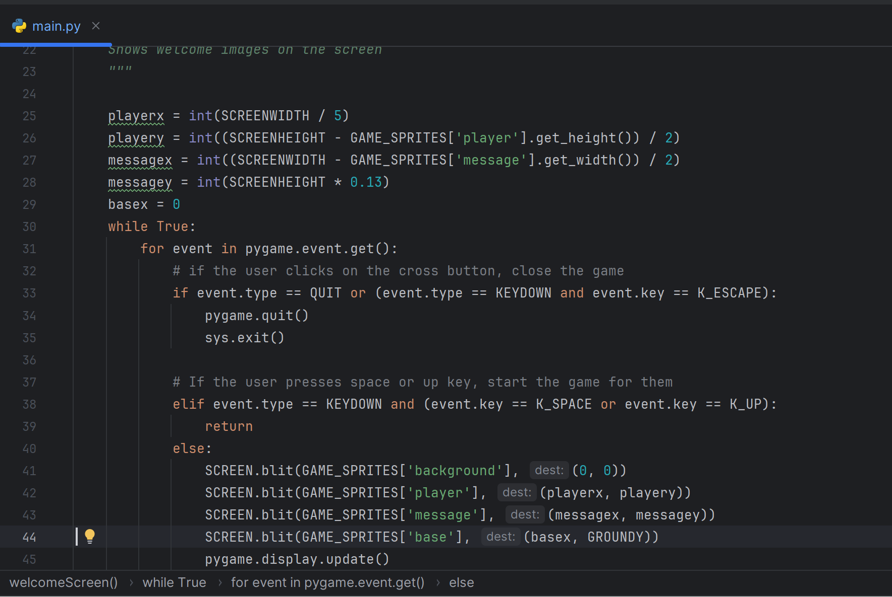
Welcome page
- This slide sheds light on the welcomeScreen() function, a pivotal component of the game's user interface.
welcomeScreen() manages the introductory visuals, displaying the game's title, player instructions, and a visually appealing background.

Slide 9
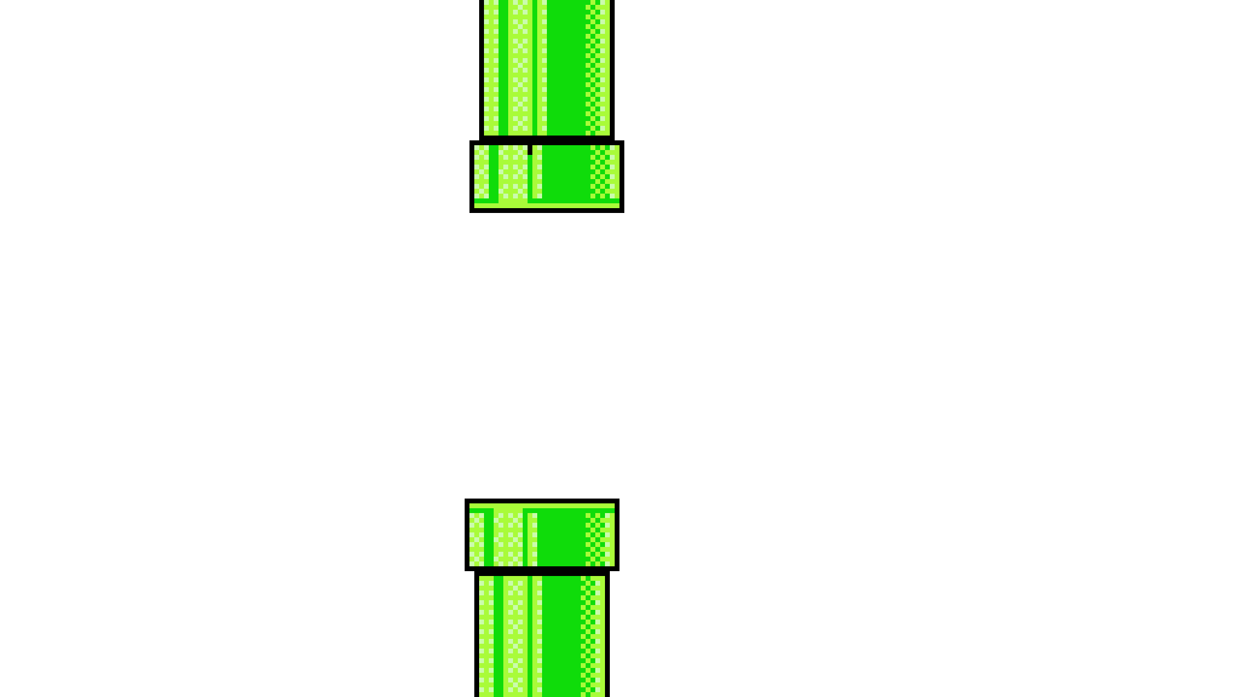
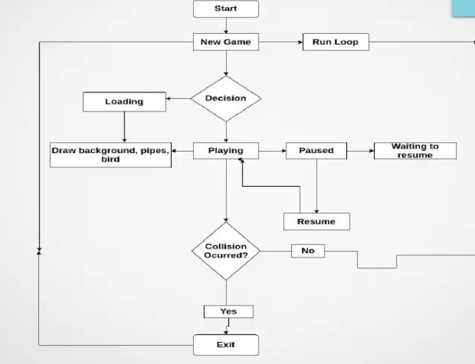
FLOWCHAT FOR FLAPPY BIRD

Slide 10
ALGORITHM
• Step 1: Start
• Step 2: Run the main Loop
• Step 3: Run the game
- If loaded:
• Draw Bird
• Draw Background
• Draw Pipes
• Step 4: While running:
- If Collision Detected:
• Go to Step 6
• Else:
• Go to Step 3
• Step 5: While paused:
Display Score
If resumed:
• Go to step 3
• Step 6: EXIT

Slide 11

CONCLUSION:
• Flappy Bird can be created using any programming language. We chose the Python language, pygame module because it is easy to use and is easy to implement game logic in pygame.
• Our project is 2D game, as pygame is specifically made for 2D games it was easy for us to create flappy bird with its user-friendly modules and methods.

Slide 12
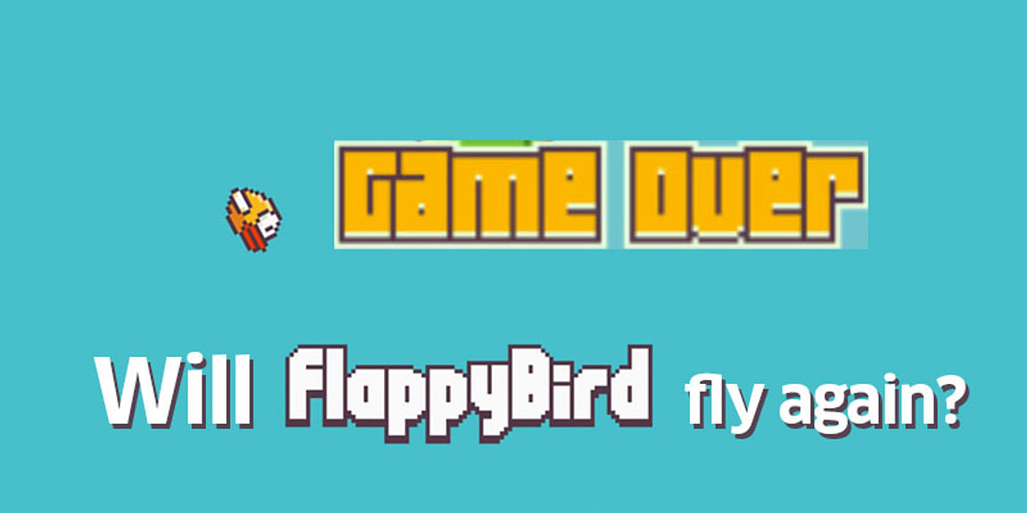
THANK YOU!!!

